Slide 1
Group 3
DevOps 2 Group Project (NUS Money)

Slide 2
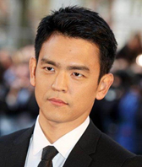
Persona : Jerry - User of NUS Money
Jerry Lee
Tech Savvy Fresh Grad
Looking to use FinTech to enhance his user experience
Would like to
Have a secure way to access his accounts
Overview of account balance
Transfer Money between accounts
Change Password

Slide 3
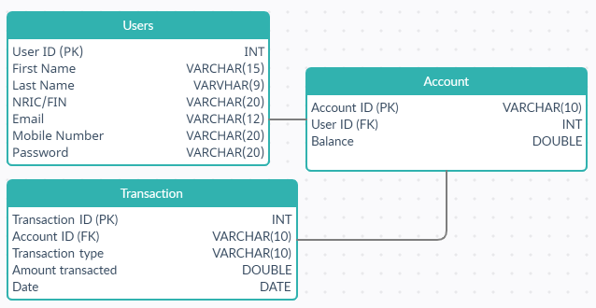
ER Diagram

Slide 4
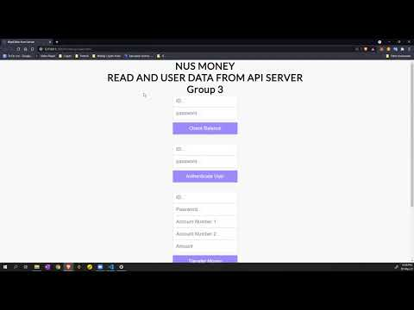
NUS Money App
Go through 4 functions
Get Account Balance
Authenticate login
Transfer money between accounts
Change Password

Slide 5
Reflections
What went well?
Great Team Dynamics
Proper division and allocation of work
Able to leverage on individual expertise to create the end product
What challenges we overcame?
Tweaking the interface was challenging with our limited JavaScript knowledge
Difficulty getting postman to function properly
Difficulty in coordinating via online platforms as compared to working in person.
Having the patience to debug and troubleshoot errors.

Slide 6
Reflections
How could we extend our prototype?
Enhance functions and capabilities
Two Factor Authentication (2FA) for added security
Transfer money to multiple accounts at one go
Overview of money inflow and outflow for expenses tracking
Alert/Notifications for unusual transactions
Comparison of spending/saving patterns with people of the same age group

Slide 7
Thank you!
Group 3

